Slide 1
Identify Anomalous Behaviour by Analyzing Web Access Logs
Anomaly Detection in Time Series
Thenuka Thanabalasingam
Owen Wang
Runhe Zhong

Slide 2
Contents
Background
Project objectives
One-Class SVM & Isolation Forest
Challenges during execution
Results & Discussion
Lesson learnt

Slide 3
Background

Slide 4
Background
Monitoring server logs could identify server outage or possible cyber attacks at an early stage.
According to Comparitech, 78% of Canadian companies were under cyber attack at least once in 2020. In 2021, the number of Canadian companies experienced cyber attack has increased to 85.7% (A. O'Driscoll, August 1st, 2022).
In the third quarter of 2022, ransom DDoS attacks has increased by 67% compare with the same time last year and with an increase of 24% if compare with the previous quarter. More than 20% of the DDoS attacks fall into the multi-vector DDoS attack category (S. Cook, November 6th, 2022).

Slide 5
Project objectives

Slide 6
Project objectives
To build a machine learning model to identify abnormal activities in web access logs

Slide 7
One-Class SVM
&
Isolation Forest

Slide 8
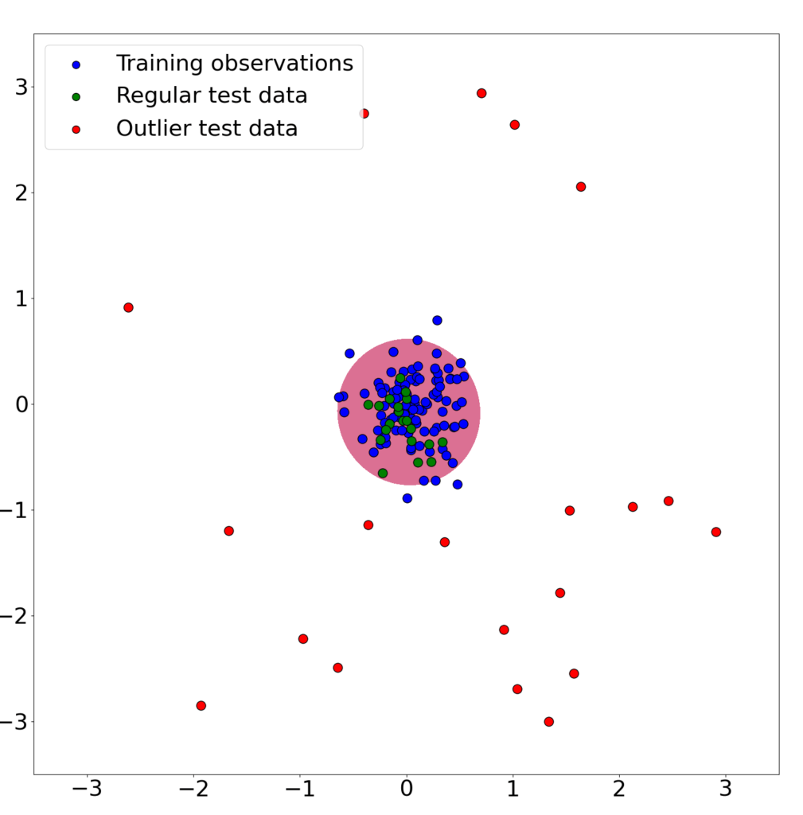
One-Class SVM
One-Class SVM is similar to basic SVMs, but it only has one class. A boundary is set based on current data. It detects an outlier, if there is any, when new data comes in.
Figure 1. Simple Example Results. from What is One Class SVM and How Does It Work? (https://www.baeldung.com/cs/one-class-svm)

Slide 9
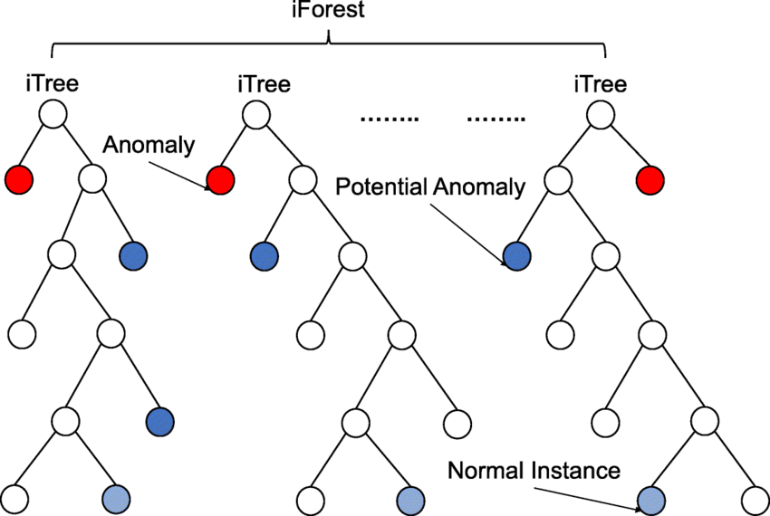
Isolation Forest
Isolation Forest is similar to Random Forest. They are all based on decision trees. It randomly selects data and process them with random features. In each tree, the branches that are shorter are (potential) anomalies, because it is easier to isolate them.
Figure 2. Regaya, Yousra & Fadli, Fodil & Amira, Abbes. (2021). Point-Denoise: Unsupervised outlier detection for 3D point clouds enhancement. Multimedia Tools and Applications. 80. 1-17. 10.1007/s11042-021-10924-x.

Slide 10
Challenges during execution

Slide 11
How to confirm if our algorithms work
-- NYC Taxi Traffic
Challenge: unable to identify anomalies directly from the data for evaluation
Solution: first build an ML anomaly detection strategy on a dataset where we already know the anomalies - NYC Taxi Traffic dataset & then apply it to ECLog Data
Smaller dataset
Validated anomalies part of dataset description (on Christmas, historic snow storm & Labour Day) that can be annotated
Additionally, this will make our model generic and easy to translate to other datasets.
Notes:
Reasons to use multiple data sets:
Want to make the model generic and easy to apply to other data set
Can map taxi data set anomaly to events - Christmas, snow storm, new year
Taxi data set can be manually labelled and measured
With the E-Commerce serve access logs, we are unable to identify anomalies directly from the data. Therefore, to validate our approach, we first decided to build an ML anomaly detection strategy on a dataset where we already know the anomalies. This led us to the NYC Taxi Traffic dataset. It’s quite similar to the E-Commerce server access logs, in that it’s periodic and unsupervised, but the NYC Taxi Traffic dataset is smaller and easier to read. Additionally, we know that the anomalies are tied to specific calendar events, like Christmas, snow storm, Labour Day, etc. If we show that we are successful in building an anomaly detection algorithm for the NYC Taxi Traffic dataset, it will validate our approach for the E-Commerce server access logs.
Additionally, this will make our model generic and easy to translate to other datasets.

Slide 12
Results & Discussion

Slide 13
NYC Taxi Dataset
-- One-Class SVM
Please refer to our code

Slide 14
NYC Taxi Dataset
-- Isolation Forest
Please refer to our code

Slide 15
E-Commerce server access logs
-- One-Class SVM
Please refer to our code

Slide 16
E-Commerce server access logs
-- Isolation Forest
Please refer to our code

Slide 17
Lesson learnt

Slide 18
One-Class SVM vs Isolation Forest
We noticed while working on this project that the performance of One-Class SVM was not as good as Isolation Forest after we run the algorithms. After reading a few articles, we realized that in order for One-Class SVM to perform well, we needed a clean training dataset to train the model and set the boundary to detect outliers in the testing dataset.
Therefore, for our second iteration, we focused on training our model with data without any anomalies.

Slide 19
Questions?

Slide 20
References
https://www.comparitech.com/blog/information-security/canada-cyber-crime-statistics/
https://www.comparitech.com/blog/information-security/ddos-statistics-facts/
https://www.baeldung.com/cs/one-class-svm
https://www.analyticsvidhya.com/blog/2021/07/anomaly-detection-using-isolation-forest-a-complete-guide/
https://www.researchgate.net/figure/Isolation-Forest-learned-iForest-construction-for-toy-dataset_fig1_352017898
https://dataverse.harvard.edu/dataset.xhtml?persistentId=doi:10.7910/DVN/Z834IK
https://www.kaggle.com/datasets/julienjta/nyc-taxi-traffic

